Slide 1
Introduction To Cuncurrency Control In DBMS
Concurrency Control in DBMS is a mechanism used to manage the simultaneous execution of multiple transactions in a database to ensure data consistency, data integrity, and correctness.
concurrency control ensures that when multiple users access or modify the same database at the same time, their operations do not interfere with each other or produce incorrect results
It Provides :
Data Consistency : must follow database rules .
Data Integrity : overall accuracy and must be reliable
Correctness ! Output must be correct , no matters how many transactions are simultaneously happens

Slide 2
Problems That Occur Without Concurrency Control
When multiple transactions execute simultaneously without proper coordination, several problems can occur.
1. Lost Update Problem
A lost update occurs when two transactions modify the same data, and one transaction overwrites the changes made by another transaction.
Example:
Initial balance = Rs. 10,000.
Transaction A withdraws Rs. 3,000.
Transaction B withdraws Rs. 2,000.
Both read the original balance which is 10,000.
One transaction overwrites the other's update.

Slide 3
Problems That Occur Without Concurrency Control
When multiple transactions execute simultaneously without proper coordination, several problems can occur.
1. Lost Update Problem
Expected balance = Rs. 5,000.
Actual balance may incorrectly become Rs. 7,000 or Rs. 8,000.

Slide 4
Problems That Occur Without Concurrency Control
2. Dirty Read Problem
A dirty read occurs when one transaction reads data that has been modified by another transaction but has not yet been committed.
Example:
Imagine a bank account has Rs. 10,000.
Transaction A changes the balance to Rs. 5,000.
Transaction A has not committed the transaction yet.
Transaction B reads the balance as Rs. 5,000.
Transaction A performs ROLLBACK.
The actual balance returns to Rs. 10,000.
Transaction B has read uncommitted and temporary data.
This is called a Dirty Read.

Slide 5
Problems That Occur Without Concurrency Control
3:Non-Repeatable Read (Fuzzy Read) Problem
A non-repeatable(means a different data comes on every read) read happens when a transaction reads the same data item twice, but another transaction modifies or deletes that data between the two reads. As a result, the first transaction gets two different values for the same query.
Example:
Transaction A reads an item's price and sees $50. Meanwhile, Transaction B updates the price to $60 and commits. When Transaction A reads the exact same item again later in the same transaction, it now sees $60.

Slide 6
Problems That Occur Without Concurrency Control
4. Phantom Read Problem
A phantom read occurs when a transaction executes a query to retrieve a set of rows satisfying a condition, but another transaction inserts or deletes rows that match (or no longer match) that condition during the first transaction. When the first transaction runs the query again, a "phantom" row appears or disappears.
Example:
Transaction A queries for all employees with a salary greater than $50,000 and finds 5 employees. Transaction B inserts a new employee with a salary of $60,000 and commits. If Transaction A runs the exact same query again, it now finds 6 employees. (Note: While similar to a non-repeatable read, non-repeatable reads involve existing rows changing, whereas phantom reads involve rows being added or deleted)

Slide 7
Lock-based Protocols.
A Lock-Based Protocol is a concurrency control technique/rules in DBMS that controls access to database items by using locks. It ensures that multiple transactions can access the database safely without causing data inconsistency.
Instead of letting transactions access data haphazardly, a lock-based protocol requires a transaction to request permission (a lock) before it can read or write a data item.
A lock is a mechanism that controls whether a transaction can read or modify a particular data item.
Before accessing a data item, a transaction must acquire an appropriate lock

Slide 8
Why Are Lock-Based Protocols Necessary?
1. Data Consistency: It ensures that the data in the database always remains correct and accurate.
2. Avoiding Conflicts: It prevents transactions from conflicting with each other, such as reading and writing the same data at the same time.
3. Eliminating Anomalies: It helps prevent problems that can occur without proper control, such as Lost Updates and Dirty Reads.

Slide 9
Two main types of locks are used in these protocols:
1:Shared Lock (S-Lock) :It is used only for reading data. Other transactions can also read the same data, but they cannot modify it.
2:Exclusive Lock (X-Lock): It is used for both reading and writing (updating/deleting) data. Only one transaction can have full control over the data at a time, while all other transactions must wait until the lock is released.

Slide 10
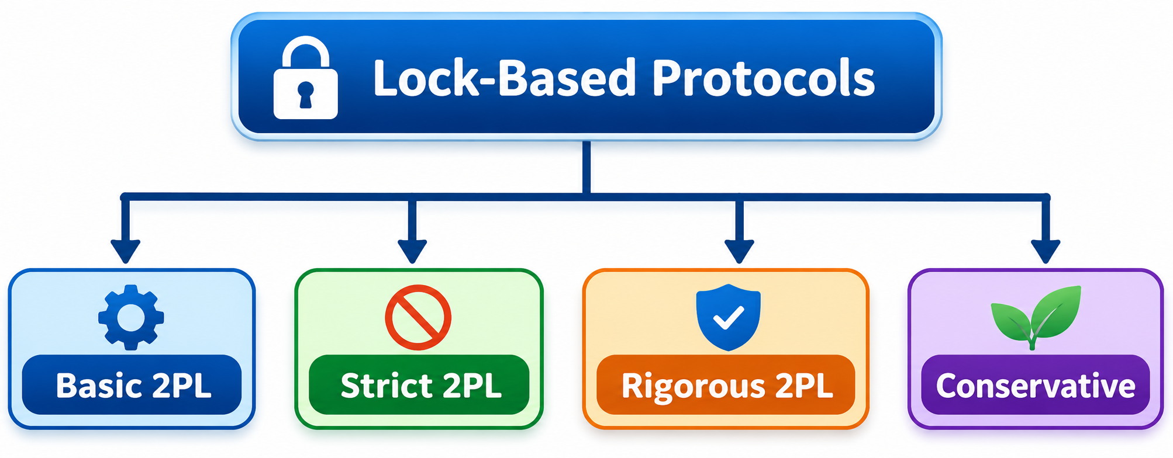

Slide 11
2PL
2PL is called "Two-Phase Locking" because the life cycle of a transaction is divided into two separate phases.
1 :Growing Phase (Lock Acquisition Phase):
2:Shrinking Phase (Lock Release Phase):

Slide 12
Growing Phase (Lock Acquisition Phase):
In this phase, a transaction can only acquire new locks:
A transaction cannot release any lock during this phase.
Eliminating Anomalies: It helps prevent problems that can occur without proper control, such as Lost Updates and Dirty Reads.
Shrinking Phase (Lock Release Phase):
1:As soon as a transaction releases its first lock, it enters the second phase.
2:In this phase, a transaction can release its existing locks, but it cannot acquire any new locks.

Slide 13
Why Is 2PL Necessary?
Serializability Guarantee: 2PL ensures that no matter how much transactions overlap with each other, their final result will always be equivalent to some valid serial schedule.
Prevention of Anomalies: It helps prevent problems such as Lost Updates, Dirty Reads, and Non-repeatable Reads.

Slide 14
Timestamp Ordering Protocol (DBMS)
Timestamp Ordering is a concurrency control protocol in DBMS that uses timestamps to determine the order in which transactions can read and write data.
Every transaction is assigned a unique timestamp when it starts. The database uses these timestamps to decide which transaction should execute first and which should execute later.
Suppose two transactions are running:
Transaction T1 → Timestamp = 10 (Older)
Transaction T2 → Timestamp = 20 (Newer)
Since T1 has the smaller timestamp, it must be executed before T2 logically.

Slide 15
Timestamp Ordering Protocol (DBMS)
Characteristics:
Every transaction gets a unique timestamp.
Older transactions have smaller timestamps
The protocol maintains a consistent order of transactions.
If an operation violates the timestamp order, the transaction may be rolled back and restarted.
Unlike Lock-Based Protocols, Timestamp Ordering does not use locks to control concurrent transactions.

